Slide 1
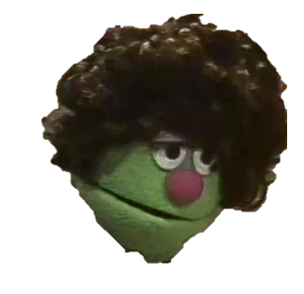

Movie review rating prediction
Martin and Ole Jonas
A comparison between a transfer-learned RoBERTa model against a XGBoost model
https://static.wikia.nocookie.net/muppet/images/b/bb/Roberta.JPG/revision/latest?cb=20200925003124

Slide 2
01
Agenda
Motivation
02
Architecture
03
Data
04
Experiments and results
05
Conclusion and future work

Slide 3
Motivation
Some movie sites don't let users post ratings with reviews :(
How could we combat this HUGE problem?
Testing out some newer NLP methods

Slide 4
Architecture
https://static.wikia.nocookie.net/muppet/images/b/bb/Roberta.JPG/revision/latest?cb=20200925003124

Slide 5
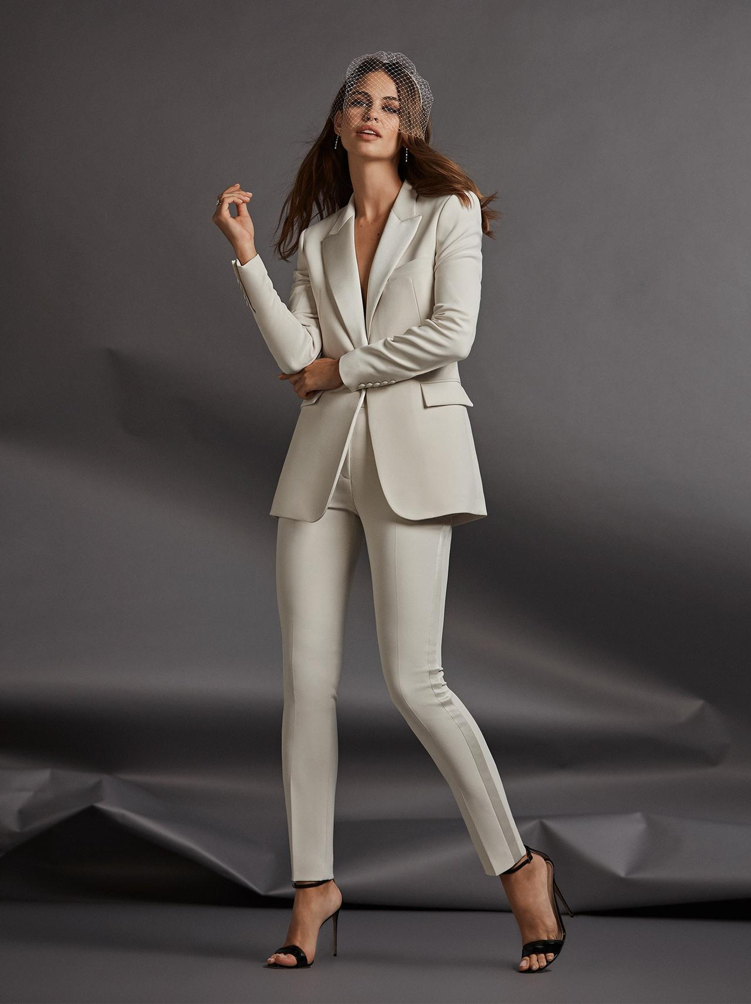
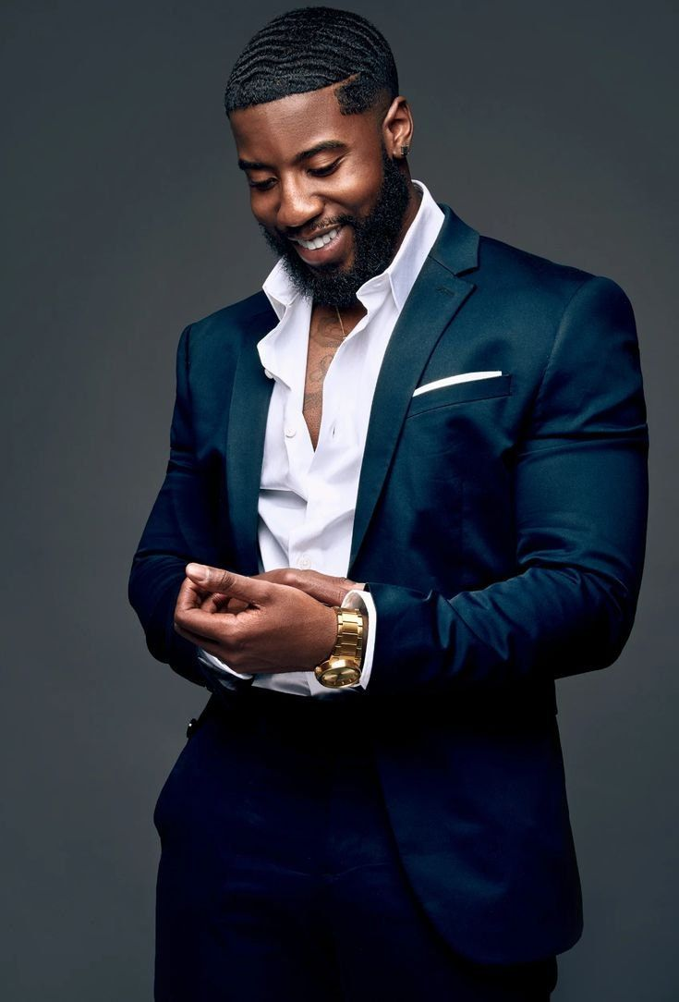
Models
Notes:
https://i.pinimg.com/736x/9a/82/10/9a82105b98fcd569a05544178e325317.jpg

Slide 6

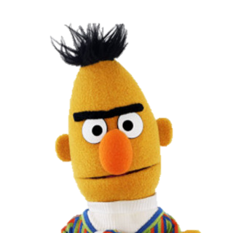
Models
RoBERTa - base
XGBoost
💧
Notes:
https://i.pinimg.com/736x/9a/82/10/9a82105b98fcd569a05544178e325317.jpg

Slide 7
Data
https://static.wikia.nocookie.net/muppet/images/b/bb/Roberta.JPG/revision/latest?cb=20200925003124

Slide 8
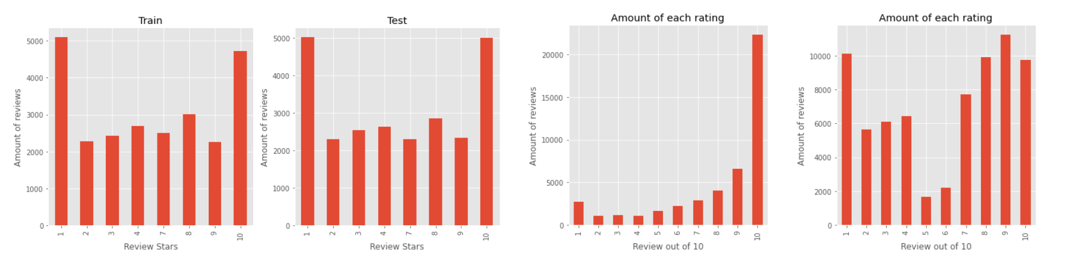
Dataset
Large movie review database - Maas et al. (2011)
Kaggle movie reviews
Highly polar
Imbalanced

Slide 9
Preprocessing
Minimal
Lose least amount of semantic meaning
Remove
User tags
Whitespaces
HTML tags

Slide 10
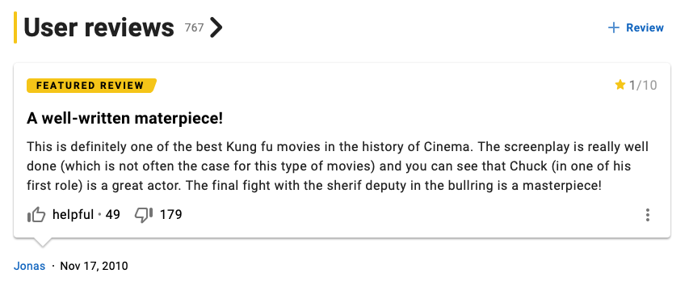
Noise
?

Slide 11
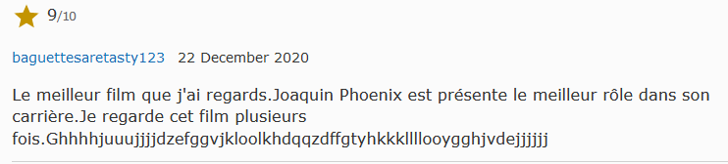
Noise

Slide 12
Experiments and results
https://static.wikia.nocookie.net/muppet/images/b/bb/Roberta.JPG/revision/latest?cb=20200925003124

Slide 13
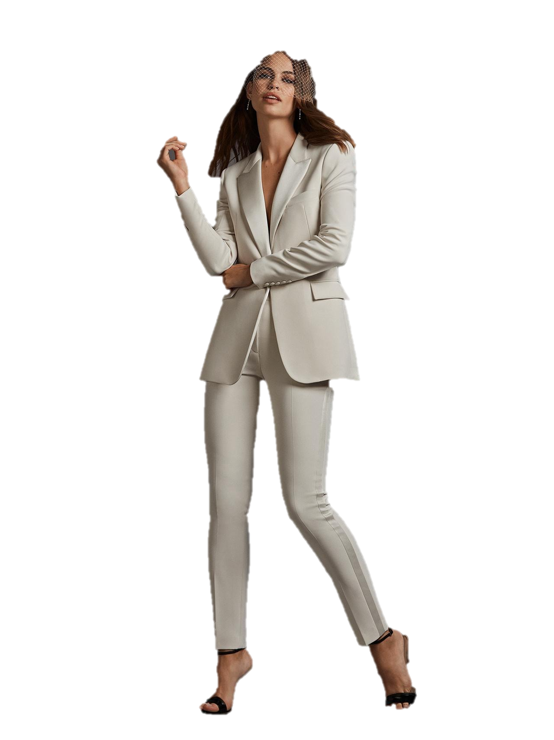
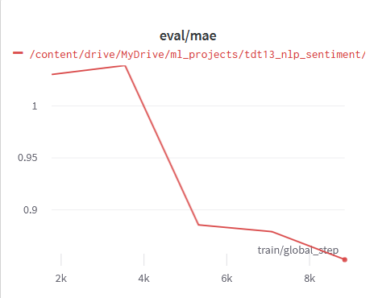
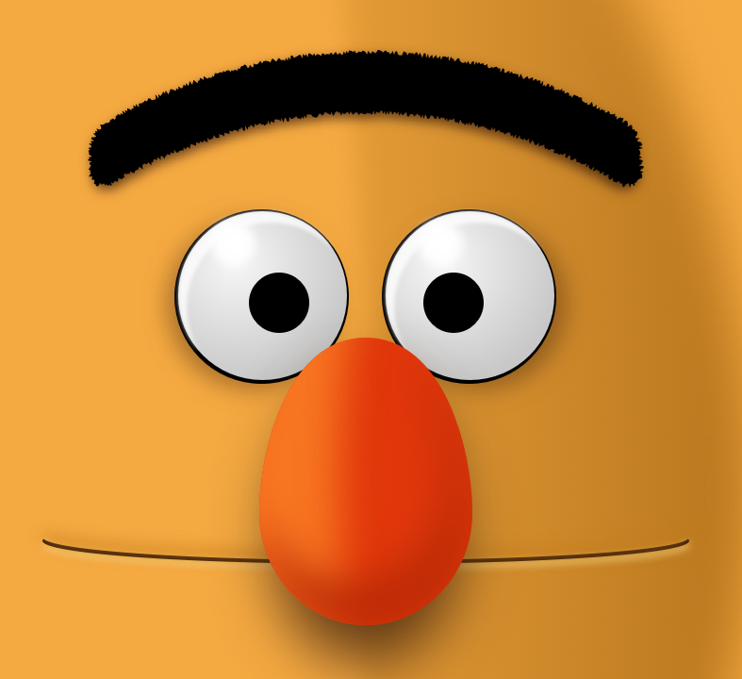
RoBERTa
85 / 15 - train/test
Regression head
5 epochs
🚣🏽
🅰️

Slide 14
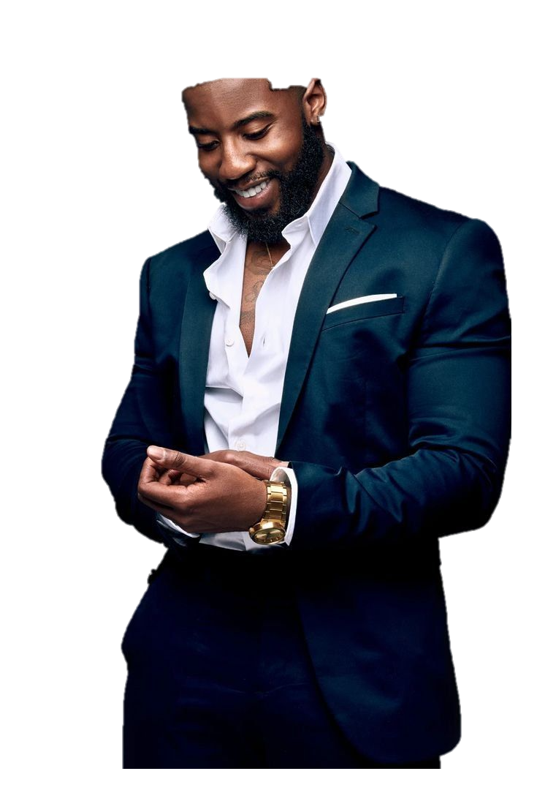
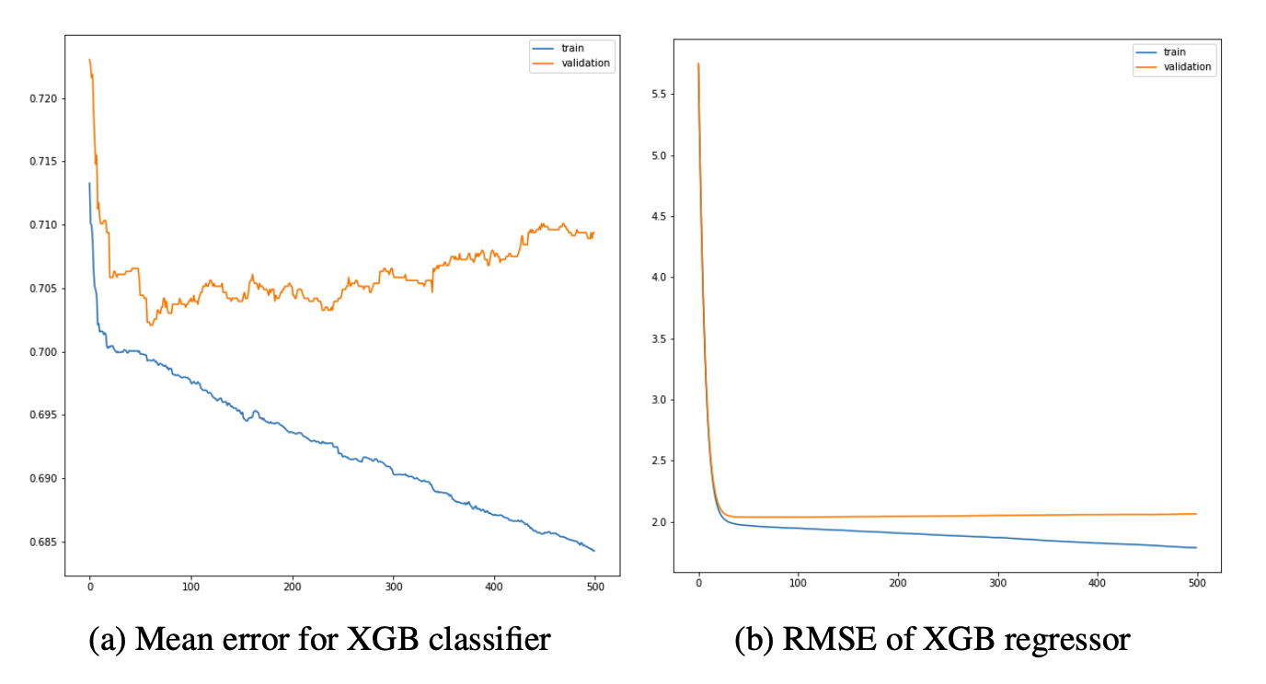
XGBoost
Used RoBERTa as an intermediary
Sentiment analysis output as features
Tried extending features with a lexical approach: VADER

Slide 15
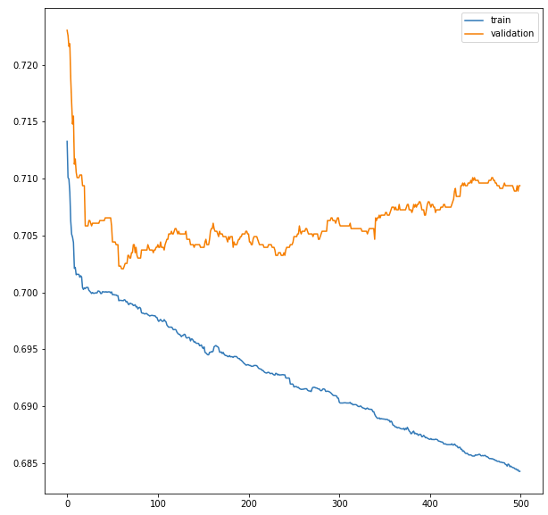
Roberta vs. XGBoost
Comparison of the two approaches
XGBoost approach performed poorly
RoBERTa impressed!

Slide 16
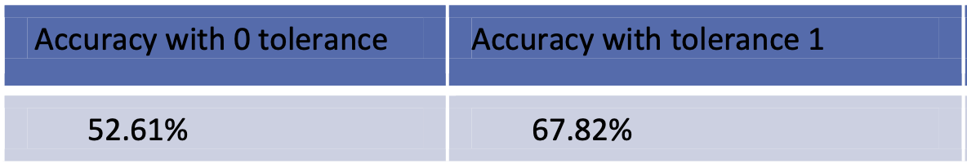
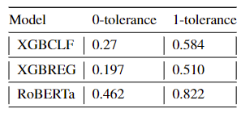
Scores
How does the model perform against Scaria et al.?
Paper
Our models

Slide 17
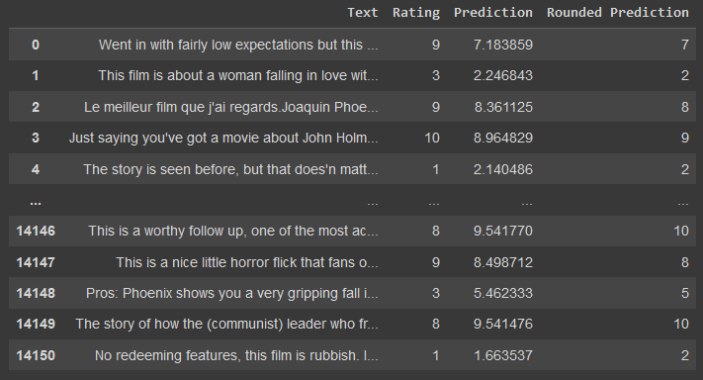
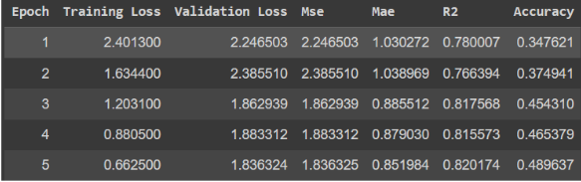
Good, but how good?
In most cases ~1 star away
MAE below 1
Training stats
Table of all misclassified reviews

Slide 18
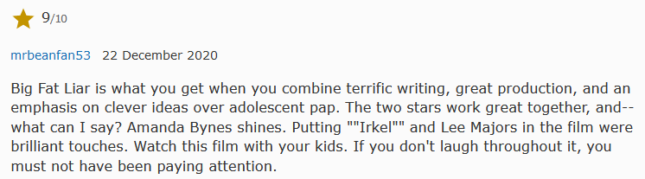
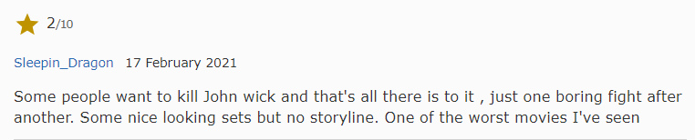
Some work
Predicted 8.85/10 ~ 9/10
Predicted 2.1/10 ~ 2/10

Slide 19
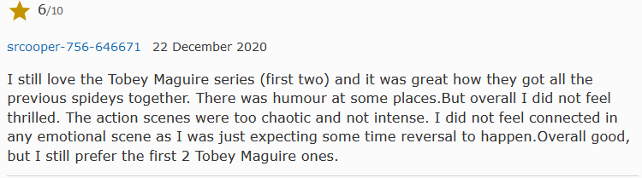
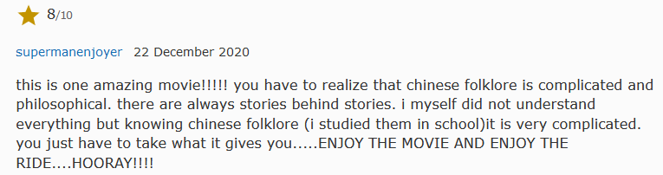
… and some don’t
Predicted 6.55/10 ~ 7/10
Predicted 9.92/10 ~ 10/10

Slide 20
Conclusion and future work
https://static.wikia.nocookie.net/muppet/images/b/bb/Roberta.JPG/revision/latest?cb=20200925003124

Slide 21
Potential improvements
Balance and clean data
Expand feature set
Experiment with other models

Slide 22
Thank you
For your attention

Slide 23
🔥
Any questions?

